Slide 1


2401FT_DS | Python Kick-Off
8 April - 10 May
James & Dare

Slide 2
01.
Announcements
02.
Python Overview
03.
Anaconda Vs Colab
04.
Coding Challenges & AutoGrader
05.
Ways of Work

Slide 3
Announcements
Things to remember…
Data Visualisation Sprint Feedback (Lesson 17)
MCQ Test due this week:
Mathematical Concepts [MCQ]
Date: 11th April 2024
Time: 23:59 (SAST/CAT)
Data Structures [Code Challenge]
Date: 12th April 2024
Time: 23:59 (SAST/CAT)
Let’s join pod sessions and retrospectives weekly

Slide 4










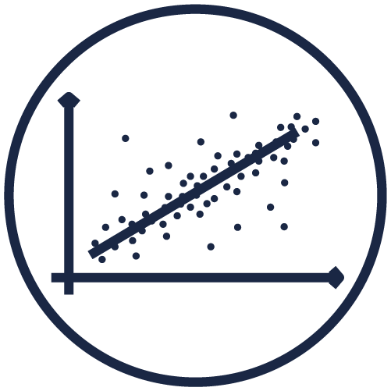

Data Science
with
_NLP_and_ _classification_
_AWS_ _foundations_
_Explore101_
_SQL_
_Python_
weeks
2
4
5
4
5
Embark on a tech-related career at almost any company!
weeks
2
3
4
4
Duration: 12 months
Pre-requisite skills: Basic analytical background
Course difficulty: Advanced
_Preparing_data_
_Data_visualisation_ _and_storytelling_
_Regression_
_Unsupervised_ _learning_
‹#›

Slide 5

Python Overview
When you hear the word 'Python', what springs to mind? 🐍
Join at:
slido.com
#2238 816

Slide 6
01.
Announcements
02.
Python Overview
03.
Anaconda Vs Colab
04.
Coding Challenges & AutoGrader
05.
Ways of Work

Slide 7

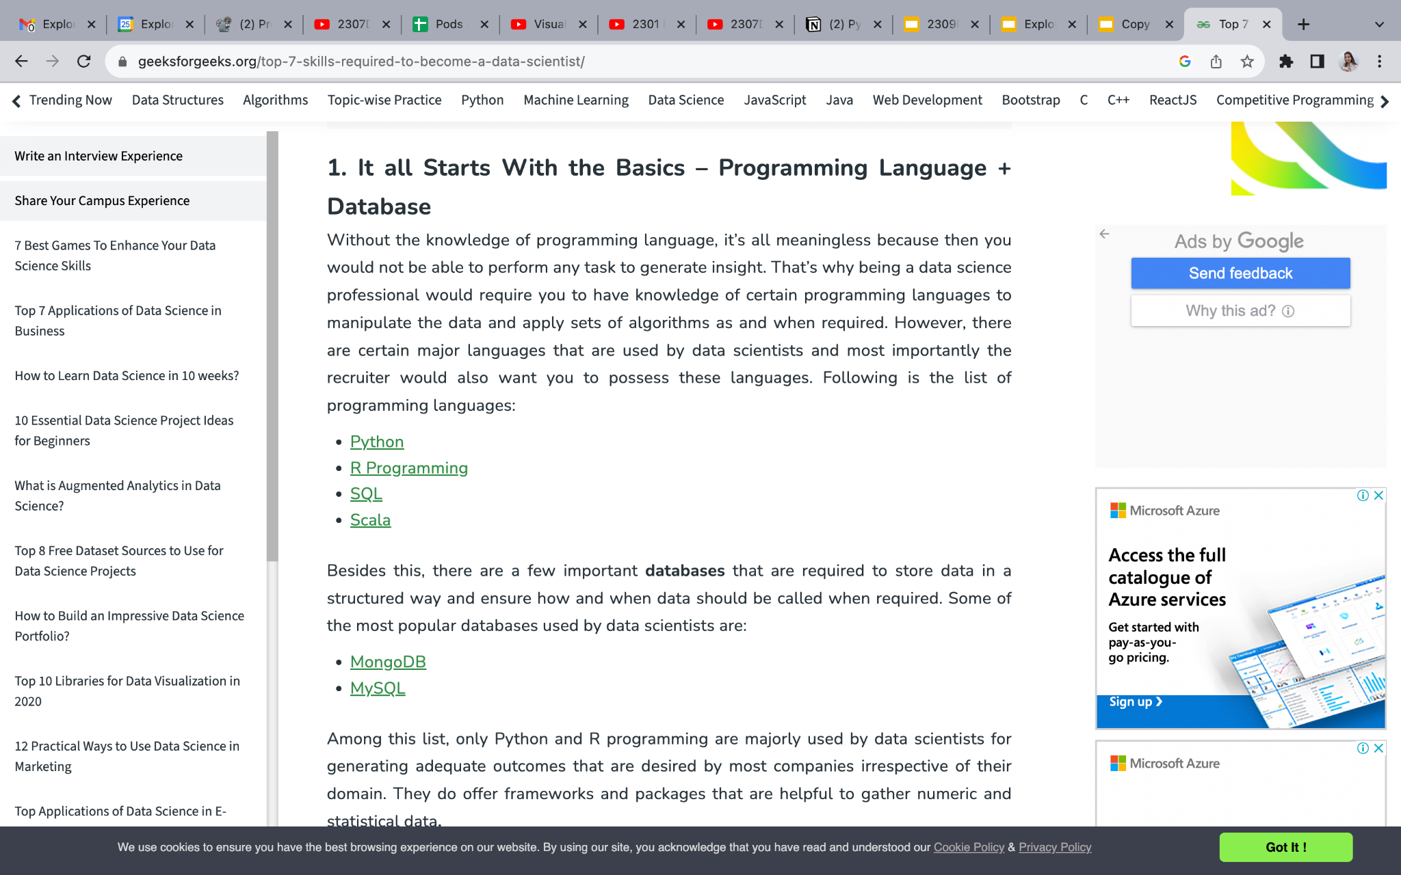
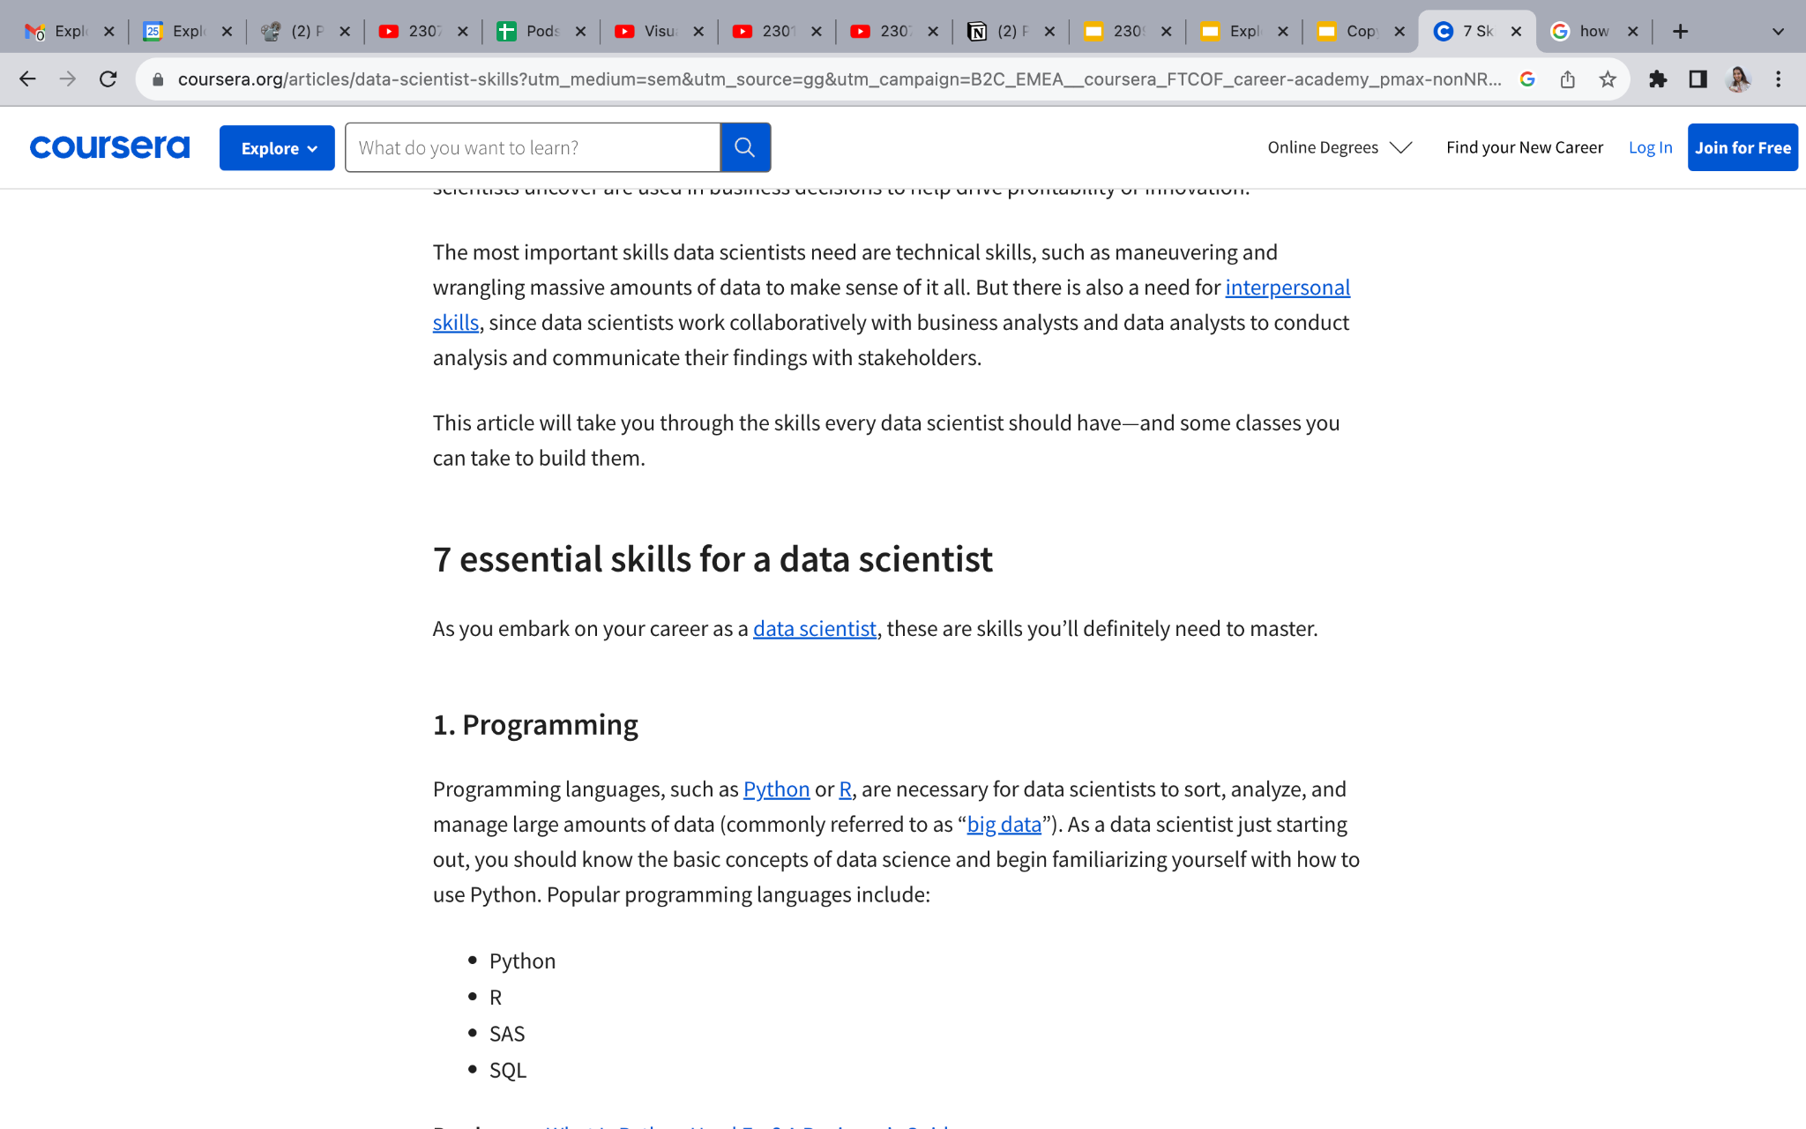
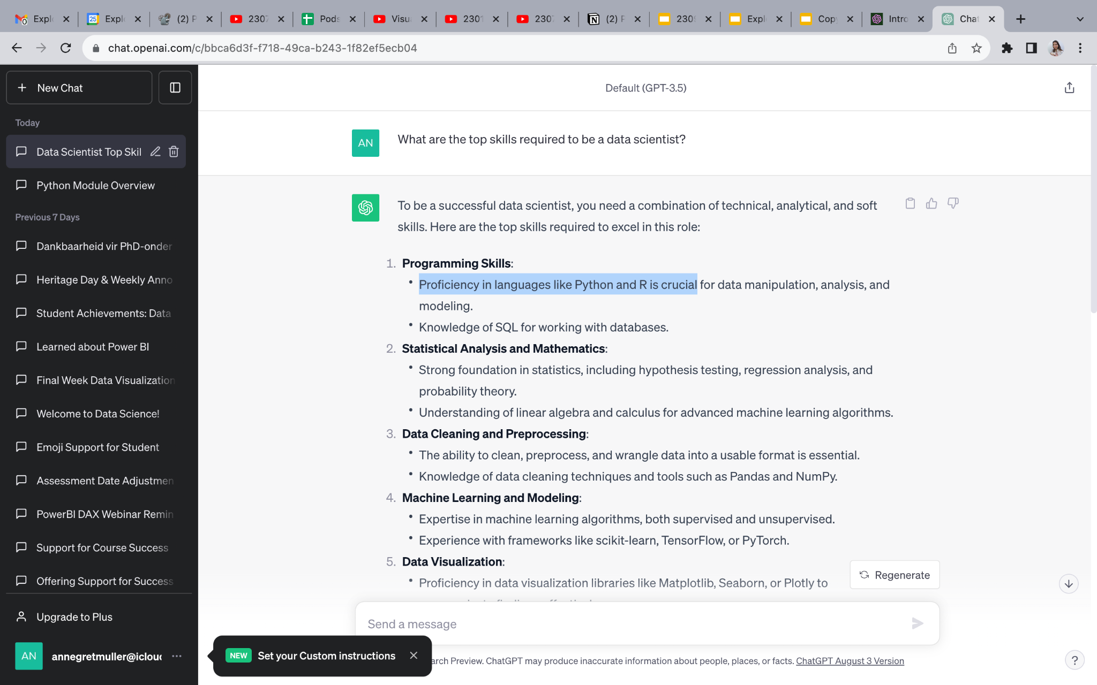

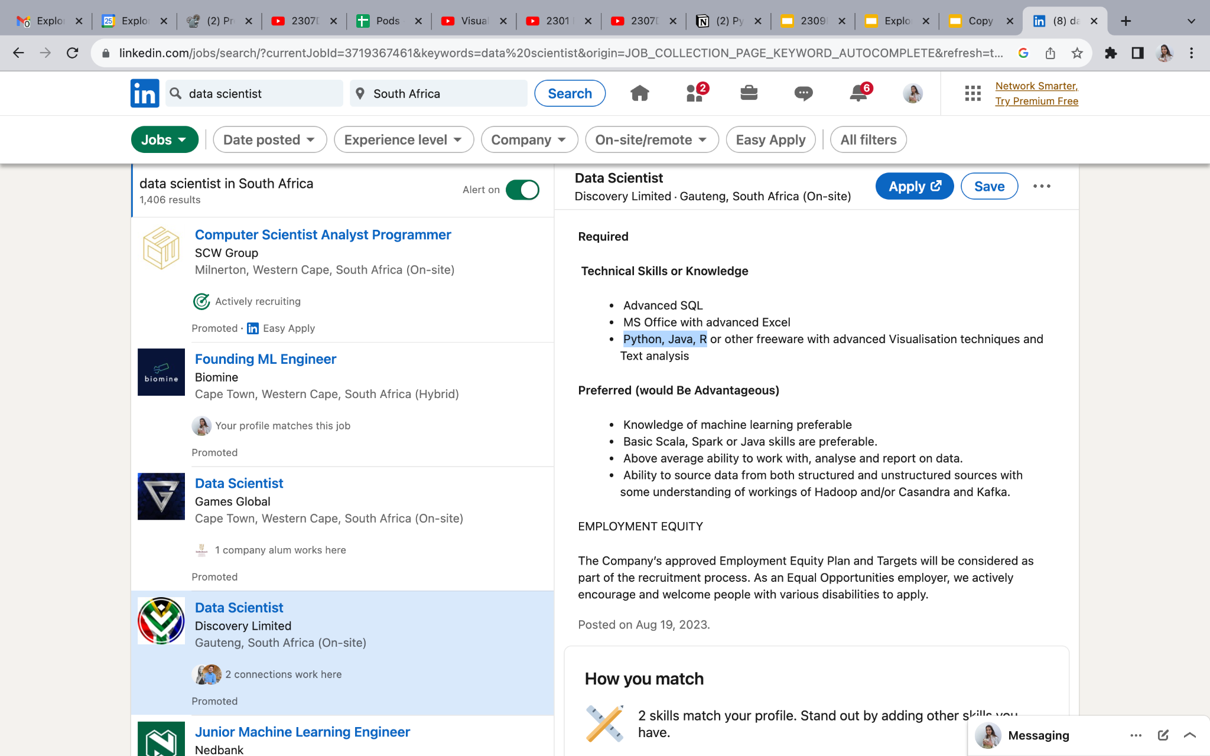

Slide 8
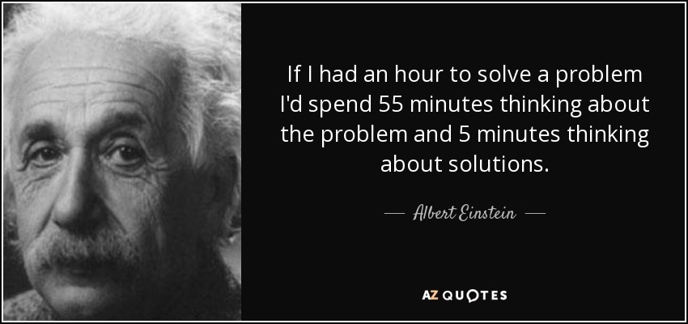
Python Overview
Why is programming an important skill for data scientists?
Programming is problem solving
Programming is a toolbox for solving problems.
Programming is chunking a problem into smaller units which are easy to solve.
Good programming allows us to solve a problem once, and apply that solution in solving other problems.

Slide 9
Python Overview
Programming Language
Python is an interpreted, high-level and general-purpose programming language.
Why Python?
Popularity behind Python
Simple, versatile and easy to maintain
Runs on an interpreter system with faster execution of code
More productive
Rich set of libraries and frameworks
Large community

Slide 10
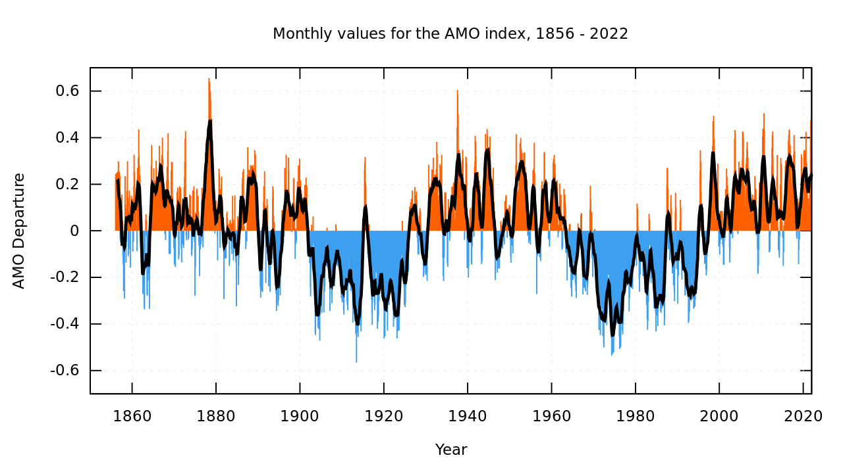






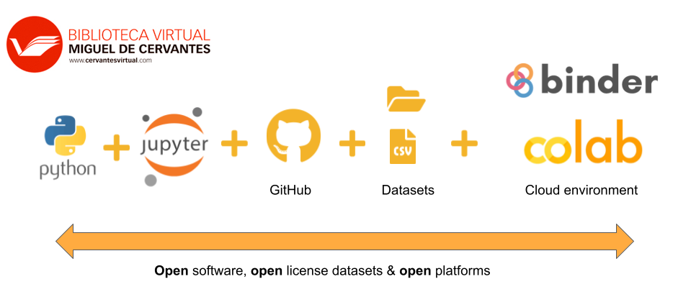




Python Overview
Applications of Python
Web Applications
Finance and Trading
Mapping and Geography
Data Science

Slide 11
Python Overview
Sprint Overview
In this module, we’re going to learn and practise data science concepts using Python.
WK 1: Fundamentals Expedition
WK 2: Version Control Voyage
WK 3: Data Discovery Expedition
WK 4: Python Powerhouse Quest
WK 5: Python Mastery Showcase
Foundational Python concepts:
syntax, variables, data types, structures, logic, and loops for problem-solving proficiency
Enhance coding practices:
Version control, reusable functions, advanced techniques, OOP fundamentals, and code standardization for clarity.
Advance data skills:
Algorithmic thinking, package integration, efficient data handling, and Pandas mastery for comprehensive data analysis
Elevate Python skills:
Advanced string manipulation, data visualization, statistical analysis, scripting, testing, and exploration of advanced topics for mastery
Apply skills in real-world scenarios through integrated projects. Demonstrate mastery in comprehensive exam testing Python fundamentals and advanced concepts

Slide 12
01.
Announcements
02.
Python Overview
03.
Anaconda Vs Colab
04.
Coding Challenges & AutoGrader
05.
Ways of Work

Slide 13


Anaconda Vs Colab
Similarities
Anaconda
Google Colab
Python Environment: Both Google Colab and Anaconda provide environments for running Python code and developing Python-based projects.
Support for Libraries: Both platforms support a wide range of Python libraries and packages commonly used in data science, machine learning, and scientific computing.
Jupyter Notebooks: Both Google Colab and Anaconda support Jupyter notebooks, allowing users to create and execute code in a cell-based format, along with Markdown and other rich media content.
Interactive Execution: Users can execute code interactively in both platforms, allowing for iterative development and exploration of data and algorithms.

Slide 14
Anaconda Vs Colab
Differences
Anaconda
Google Colab
Local Installation: Anaconda is a distribution of Python and its associated libraries, which is installed locally on a user's computer.
Cloud-based: Google Colab is a cloud-based platform provided by Google, allowing users to write and execute Python code directly in a web browser.
Package Management: Anaconda includes a package manager called conda, allowing users to easily install, update, and manage Python packages and dependencies.
Free and Convenient: It offers free access to resources like CPU, GPU, and RAM, making it convenient for running machine learning and data analysis tasks without the need for powerful local hardware.
Environment Management: Anaconda allows users to create isolated Python environments, enabling them to work with different versions of Python and libraries without conflicts.
Collaborative: Colab supports real-time collaboration, enabling multiple users to work on the same notebook simultaneously.

Slide 15
01.
Announcements
02.
Python Overview
03.
Anaconda Vs Colab
04.
Coding Challenges & AutoGrader
05.
Ways of Work

Slide 16
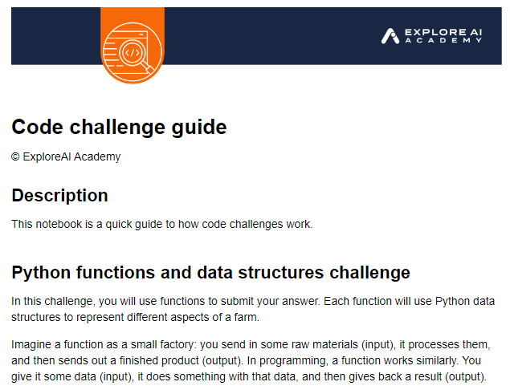
Coding Challenges & AutoGrader
Coding Challenges
Coding Challenges Coding challenges are an assessment type that allow for open text input in the form of code as solution to a problem.
Coding challenges are downloadable .ipynb files (Interactive python notebooks).
Coding challenges are graded using Auto-Grader.

Slide 17
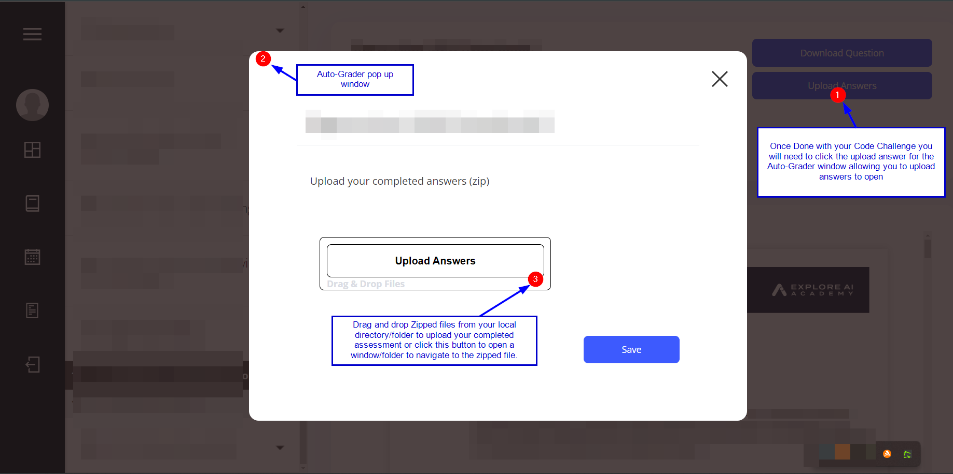

Coding Challenges & AutoGrader
Auto Grader
Auto Grader An automated grading tool for grading your completed Coding Challenges.
Auto Grader only accepts Zipped files.
Sequel to a successful upload, your grade will be in the report card section of the Coding Challenge page

Slide 18
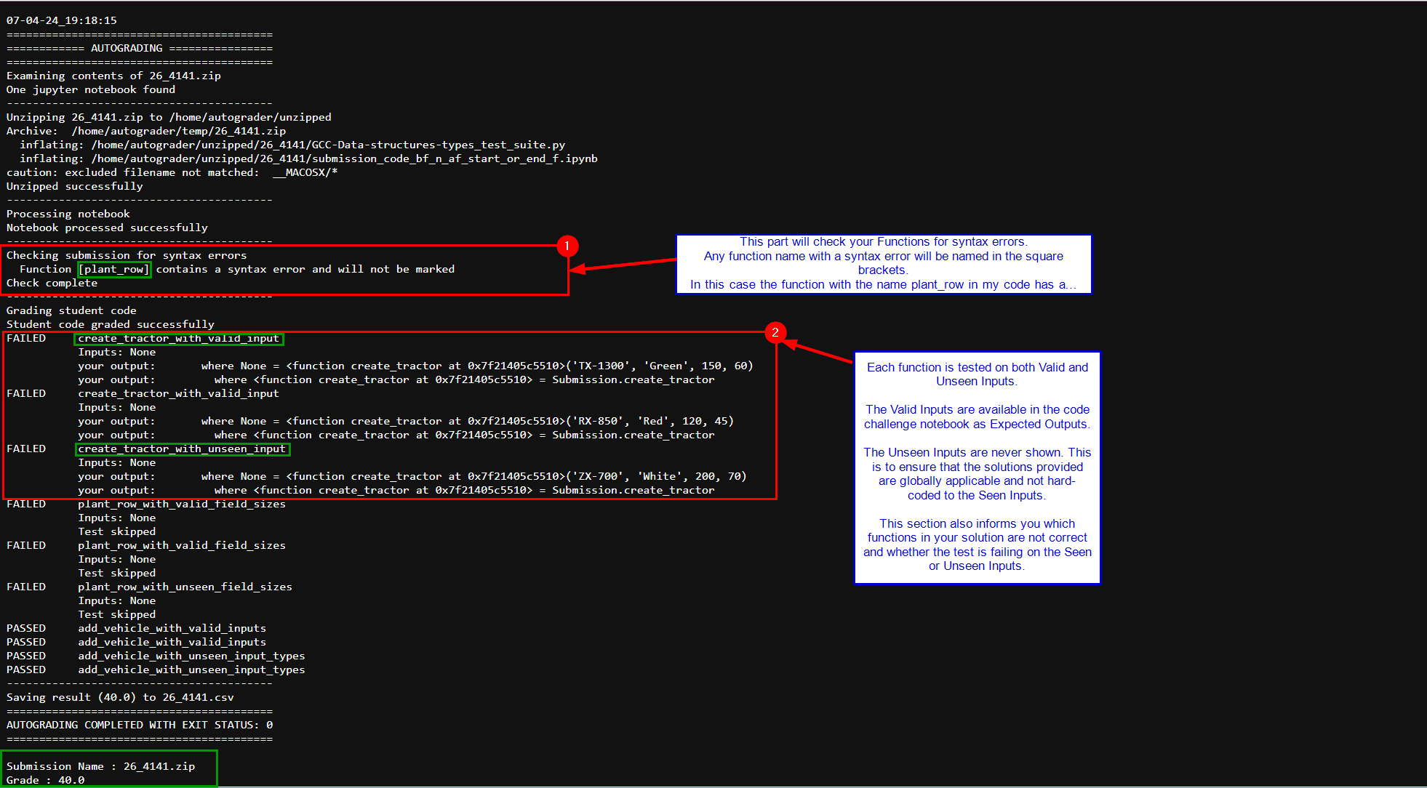
Coding Challenges & AutoGrader
Auto Grader: Graded Report

Slide 19
01.
Announcements
02.
Python Overview
03.
Anaconda Vs Colab
04.
Coding Challenges & AutoGrader
05.
Ways of Work

Slide 20
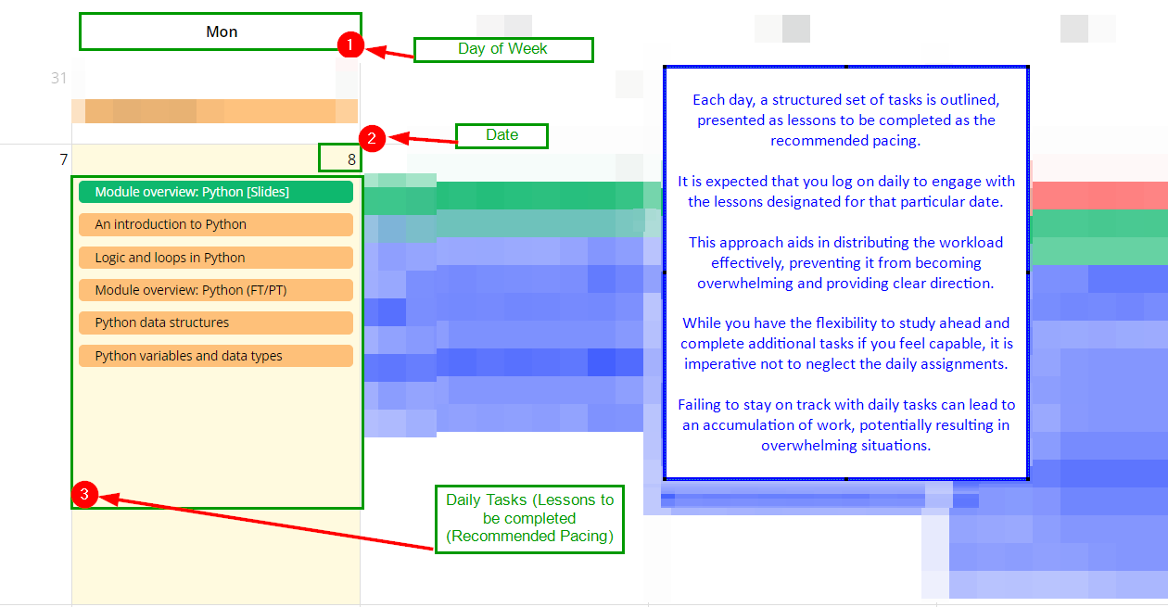
Ways of Work
The Athena Calendar

Slide 21
Ways of Work
How I learnt Python from scratch
Pomodoro technique - Dare
Coding platforms - hackerrank, etc… (continuous practice) to be shared on discord
Sequentially via the calendar, Guided projects, unguided projects.
Pen and paper breakdown of the Problem, move to trying out in the programming environment.

